Slide 1
Predicting Substance Consumption Patterns Using Behavioral Analytics and Demographic Details
Presented By
CHILLAKURU KAMAKSHI ISWARYA (22BFA05039)
C ASWINI (22BFA05028)
C K VENKATA MADHU HASITHA (22BFA05030)
K PAVAN REDDY (22BFA05045)
Under The Guidance of
Dr .A.Ganesh,
Ph.D (PDF)
Head of the Department
Department of Computer Science And Engineering S V COLLEGE OF ENGINEERING
(Autonomous)
Karakambadi Road, Opp. LIC Training Center Tirupati-517507

Slide 2
OUTLINE
Abstract
Introduction
Existing System
Proposed System
Algorithms
Conclusions
References

Slide 3
ABSTRACT
Substance use has become a major global health and social challenge.
Early detection and classification of drug users can help prevent addiction and guide interventions.
This project proposes a machine learning framework that analyzes demographic, socio-economic, psychological, and behavioral attributes to predict drug usage.
Two high-performance models — Random Forest and XGBoost — are implemented to perform:
Drug user classification
Recency prediction (when a person last used drugs)
The system provides an intelligent, data-driven approach for early identification of at-risk individuals, enabling timely prevention and policy-level support.
Keywords: Machine Learning, Random Forest, XGBoost, Drug Prediction, Behavioral Analytics, Early Detection, Recency Analysis.

Slide 4
INTRODUCTION
Drug addiction is a serious public health issue affecting both individuals and society.
Traditional detection methods rely on medical tests or self-reports, which are often inaccurate.
Machine learning can help analyze behavioral, psychological, and demographic data to detect risk early.
This project aims to build a predictive model to identify drug users and estimate the recency of their usage.

Slide 5
EXISTING SYSTEM
Reference: Behavioral and Physiological Insights into Substance Use via Feature Selection and Descriptive Analytics — IEEE, 2025.
Data Source
Addiction rehabilitation centers in Amman, Jordan; behavioral and physiological indicators collected from clinical settings
Methods Applied
Feature selection via SelectKBest, RFE, Chi-Square; descriptive analytics and correlation analysis
Key Findings
Smoking (93.59%), lying (99.1%), and irritability (96.09%) emerged as strong substance use indicators

Slide 6
EXISTING SYSTEM
Drawbacks of Existing System
Hard to Access Data
The existing system relied mainly on physiological and observable symptoms such as skin color, fatigue pallor, and redness, which are difficult to measure accurately without clinical observation.
Missing Timeline
The reference study could only identify whether certain features were correlated with substance use, but it failed to estimate when the person last consumed drugs.
Small Dataset
It included nearly 50 features such as irritability, fatigue, skin redness, and motivation loss, but the sample size was too small to ensure reliable generalization.

Slide 7
PROPOSED SYSTEM
We will develop an intelligent predictive system that advances beyond correlation analysis to actionable predictions:
Use behavioral and demographic data to predict whether a person is a drug user or non-user.
Estimate the recency of drug consumption by classifying the timeframe such as last 24 hours, month, year, or never.
Apply SelectKBest and Recursive Feature Elimination (RFE) to identify the most relevant and predictive features.
Implement and compare Random Forest and XGBoost algorithms to achieve accurate and generalizable results.
Deploy the final model through a Streamlit web interface for real-time prediction and practical use.

Slide 8
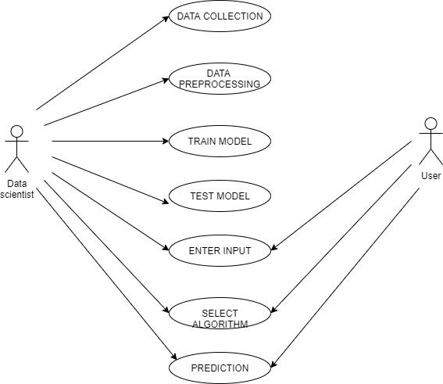
PROPOSED SYSTEM
Methodology: Research Flow

Slide 9
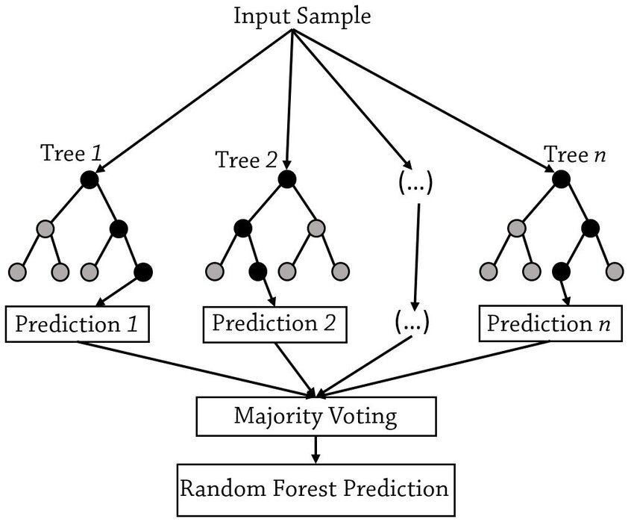
ALGORITHMS
Random Forest
The Simple Idea
Imagine asking 100 different experts the same question—each expert looks at different information. A Random Forest is like asking many decision trees (mini-experts) and taking a vote on the answer.
Why It Works
Accurate: Many opinions beat one
Reliable: Less likely to make mistakes
Flexible: Handles complex behavior data well

Slide 10
ALGORITHMS
Random Forest
How Random Forest Works
Random Forest is an ensemble learning method that combines multiple independent decision trees to make robust predictions.
Bagging approach: Creates diverse subsets of training data
Multiple trees: Each tree trained independently on random samples
Aggregation: Final prediction via majority vote (classification) or averaging (regression)
Reduced overfitting: Ensemble diversity prevents memorization of noise
Why for Our Project
Handles complex behavioral data well
Captures non-linear relationships
High accuracy on drug-user classification task
Built-in feature importance ranking

Slide 11
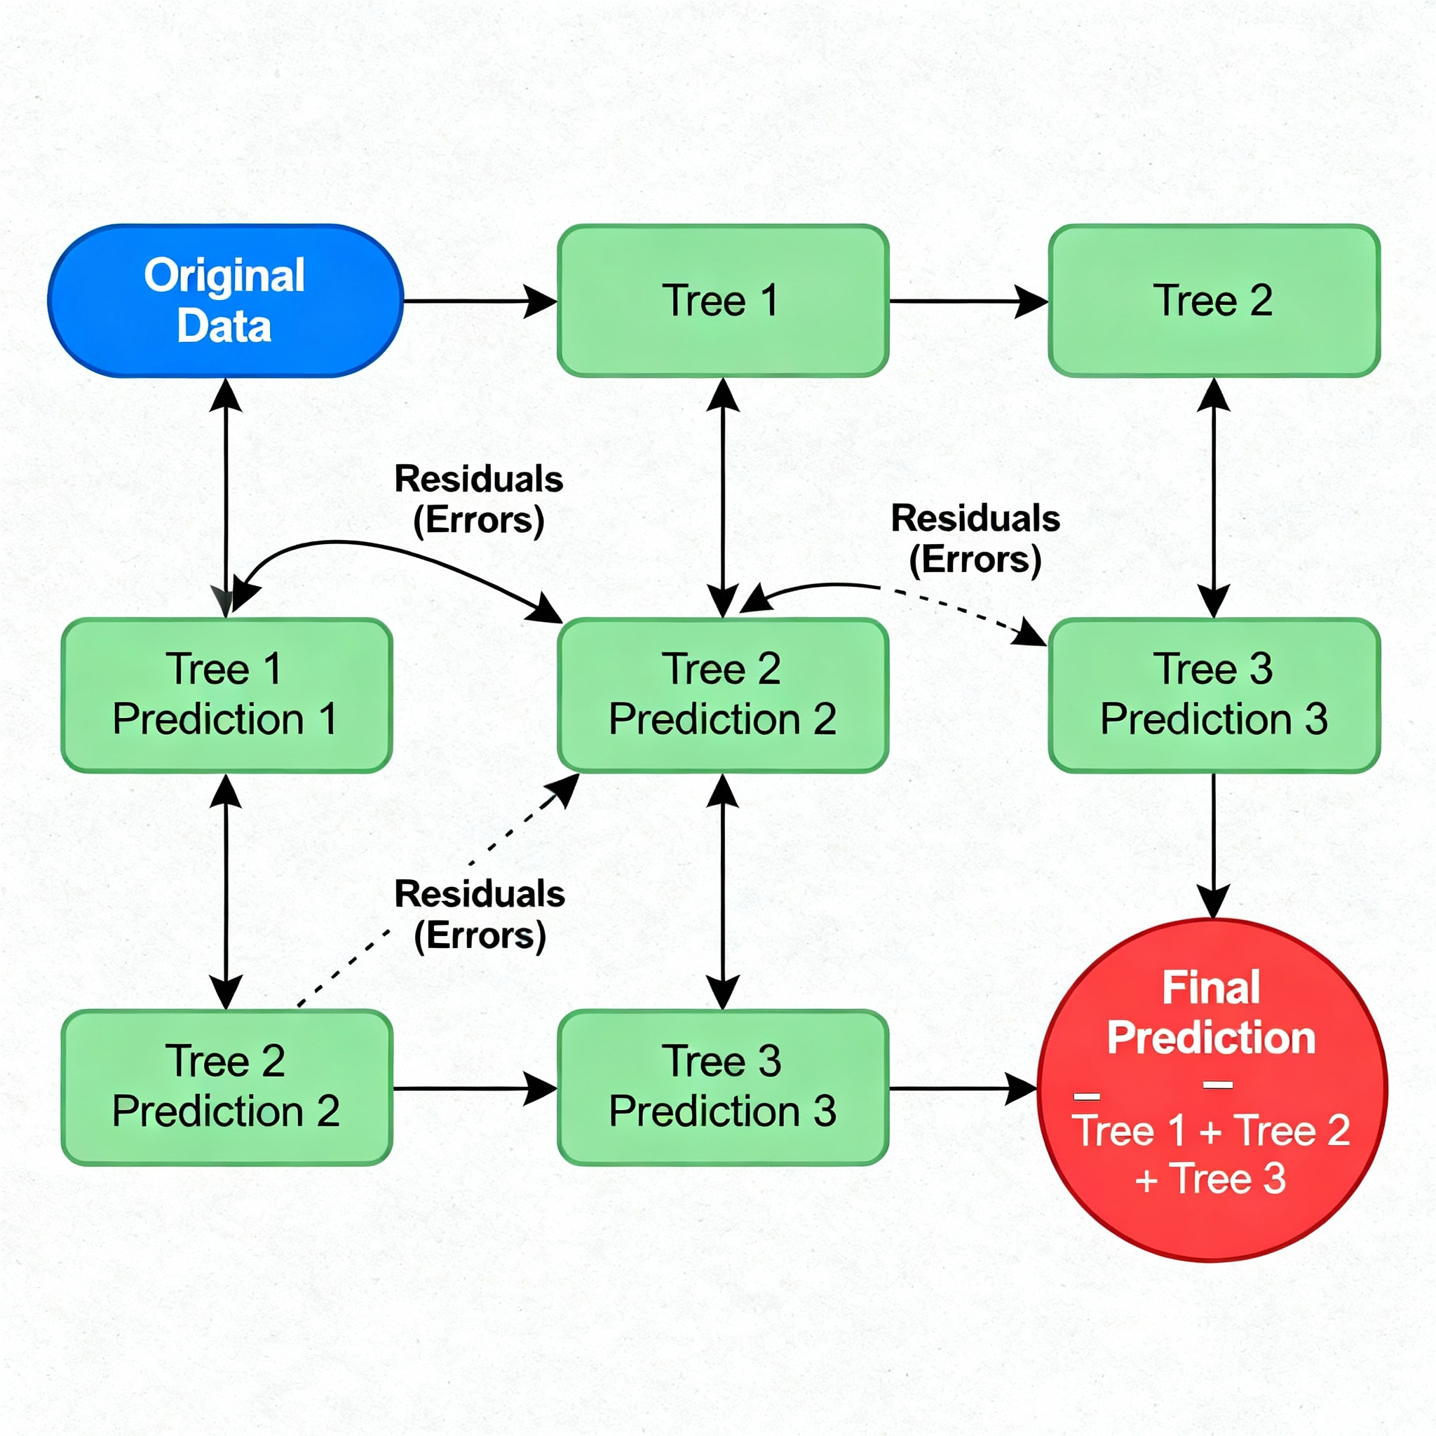
ALGORITHMS
XG Boost
The Simple Idea
XGBoost learns by correcting its own mistakes. It builds simple trees one after another, and each new tree fixes errors from the previous one. It's like a student learning gradually, getting better with each lesson.
Why We Use It
Fast: Processes data quickly
Smart: Great at multi-category predictions (our recency groups)
Strong: Makes fewer errors than most algorithms

Slide 12
ALGORITHMS
XG Boost
How XGBoost Works
XGBoost is an advanced gradient boosting algorithm that sequentially builds decision trees, with each new tree correcting errors from previous ones.
Sequential learning: Trees built iteratively to minimize residual errors
Gradient optimization: Uses gradient descent to find optimal splits
Regularization: Built-in L1/L2 penalties prevent overfitting
Weighted predictions: Each tree contributes based on its performance
Why for Our Project
Excellent for multi-class recency classification
Handles imbalanced data (drug users vs. non-users)
Fast training and inference speed
State-of-the-art performance on structured data

Slide 13
CONCLUSIONS
Drug use affects health and society, making early detection crucial.
Machine learning analyzes demographic, personality, and behavioral factors.
Predicts who uses drugs and when, supporting timely interventions.
XGBoost and Random Forest ensure accurate and reliable predictions.
The system is practical, scalable, and helps healthcare and policymakers reduce the impact of substance abuse.

Slide 14
REFERENCES
Smith, J., & Lee, R. (2021). Predicting Substance Use Patterns Using Machine Learning Techniques. Retrieved from Google Scholar.
Brown, M., & Garcia, P. (2022). AI-Driven Insights into Drug Consumption Trends: A Comprehensive Analysis. Retrieved from Google Scholar.
Patel, S., & Kumar, V. (2021). Machine Learning Applications in Understanding Drug Addiction and Relapse. Retrieved from Google Scholar.
Johnson, A., & White, L. (2023). Socio-Demographic Predictors of Drug Use: A Data-Driven Approach. Retrieved from Google Scholar.
Zhang, Y., & Lopez, E. (2022). Temporal Patterns in Drug Consumption: A Predictive Model Using Big Data. Retrieved from Google Scholar.
Green, D., & Wilson, H. (2023). Personalized Interventions for Drug Use Prevention Using Predictive Analytics. Retrieved from Google Scholar.
Martinez, F., & Taylor, K. (2021). Behavioral and Psychological Factors in Substance Abuse Prediction Models. Retrieved from Google Scholar.
Carter, N., & Singh, R. (2023). Dynamic Risk Assessment of Drug Usage Patterns with Advanced Machine Learning Models. Retrieved from Google Scholar.

Slide 15
Thank You

